Slide 1
CONNECTTEL CUSTOMER CHURN PREDICTION
DAVID JACOB IKECHUKWU

Slide 2


AGENDA
INTRODUCTION
PRIMARY GOALS
AREAS OF GROWTH
TIMELINE
SUMMARY

Slide 3

INTRO
ConnectTel is a leading telecommunications company at the forefront of innovation and connectivity solutions. With a strong presence in the global market. ConnectTel has established itself as a trusted provider of reliable voice, data, and Internet services. Offering a comprehensive range of telecommunications solutions, including mobile networks, broadband connections, and enterprise solutions, ConnectTel caters to both individual and corporate customers, they are committed to providing exceptional customer service and cutting-edge technology. ConnectTel ensures seamless communication experiences for millions of users worldwide.

Slide 4
PROBLEM OVERVIEW
connecttel telecom company faces the pressing need to address customer churn, which poses a significant threat to its business sustainability and growth. the company's current customer retention strategies lack precision and effectiveness, resulting in the loss of valuable customers to competitors. to overcome this challenge, connecttel aims to develop a robust customer churn prediction system for which i have been contacted to handle as a data scientist. by leveraging advanced analytics and machine learning techniques on available customer data, the company seeks to accurately forecast customer churn and implement targeted retention initiatives. this proactive approach will enable connecttel to reduce customer attrition, enhance customer loyalty, and maintain a competitive edge in the highly dynamic and competitive telecommunications industry.

Slide 5
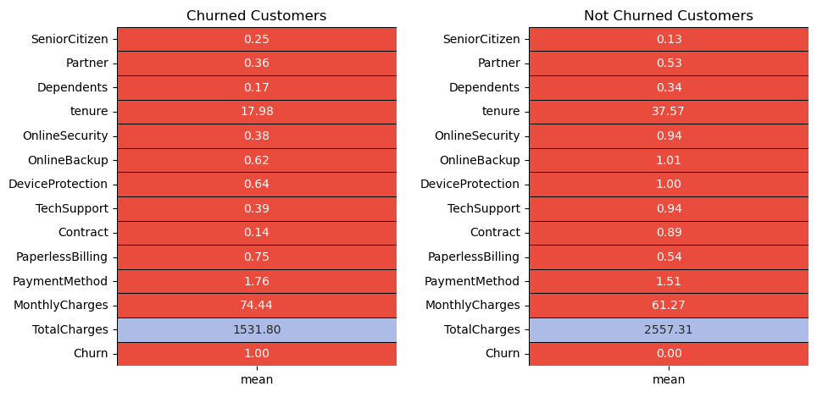
Mean values of all the features for churned and not-churned customers.

Slide 6
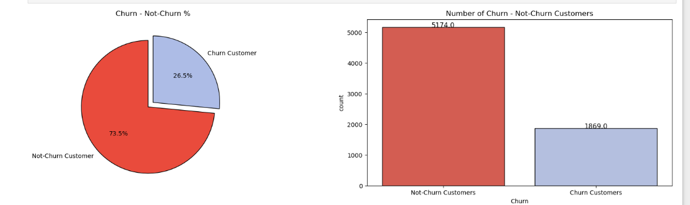
The percentage of churn customers and not churn customer. The dataset is unbalanced in a near about 3 : 1 ratio for Not-Churn : Churn customers!

Slide 7
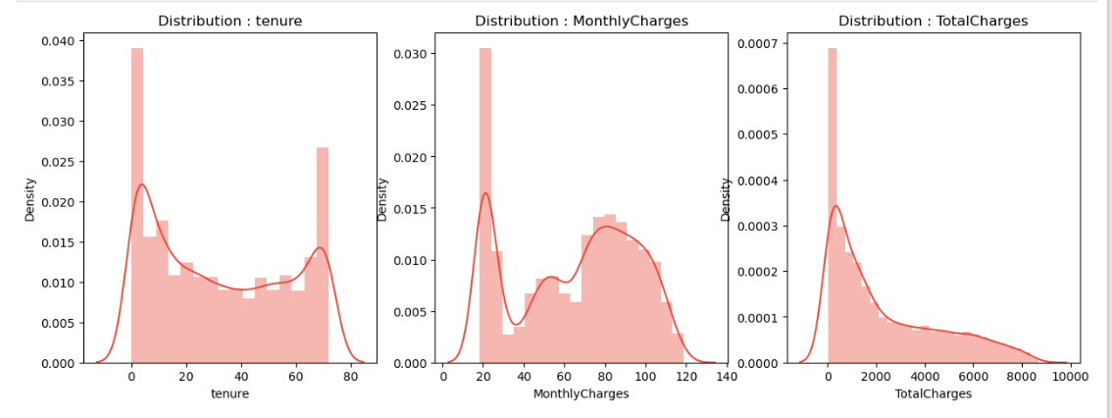
tenure and MonthlyCharges kind of create a bimodal distribution with peaks present at 0 - 70 and 20 - 80 respectively.TotalCharges displays a positively or rightly skewed distribution.
“
”

Slide 8
Summary of EDA
Order / Values of features for customer churn cases :Categorical Features (Order) :gender : Male =Female
SeniorCitizen : No SeniorCitizen > SeniorCitizen
Partner : No Partner > Partner
Dependents : No Dependent > Dependent
PhoneService : PhoneService > No PhoneService
MultipleLines : MultipleLines > No MultipleLines > No PhoneService
InternetService : Fiber Optic > DSL > No InternetService
OnlineSecurity : Absent > Present > No InternetService
OnlineBackup : Absent > Present > No InternetService
DeviceProtection : Absent > Present > No InternetService

Slide 9
Summary of EDA
TechSupport : Absent > Present > No InternetService
StreamingTV : Absent > Present > No InternetService
StreamingMovies : Absent > Present > No InternetService
Contract : Month-to-Month > One year > Two year
PaperlessBilling : Present > Absent
PaymentMethod : Electronic check > Mailed check > Bank Transfer (automatic) > Credit Card (automatic)!
Numerical Features (Range) :
Tenure : 1 - 5 months
MonthlyCharges : 65 – 105
TotalCharges : 0 – 1000
According to the EDA, these order / range of values results in customer churn!

Slide 10
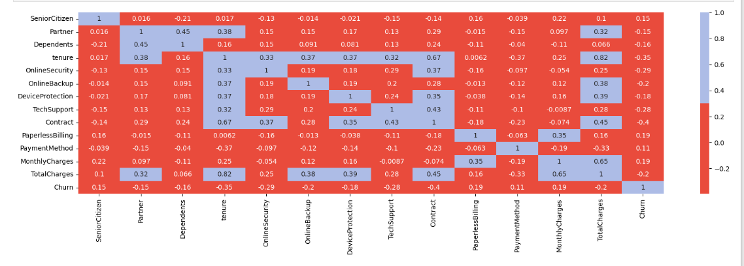
FEATURE ENGINEERING: Correlation MATRIX

Slide 11
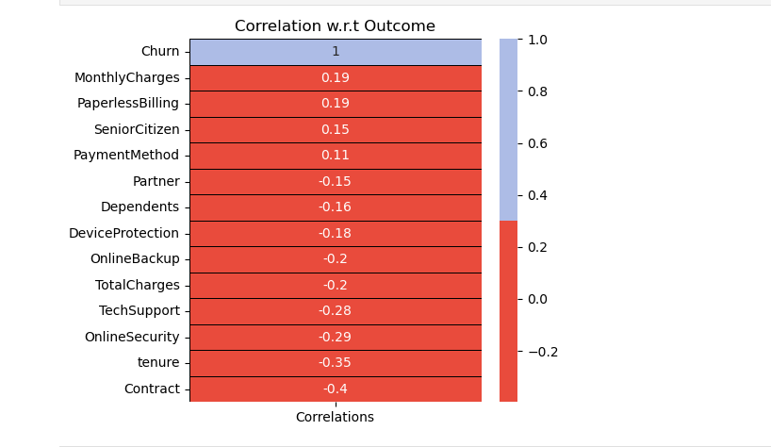
MulipleLines, Phone Service, gender, Streaming TV, Streaming Movies and Internet Service does not display any kind of correlation. We drop the features with correlation coefficient between (-0.1,0.1).Remaining features either display a significant positive or negative correlation.

Slide 12
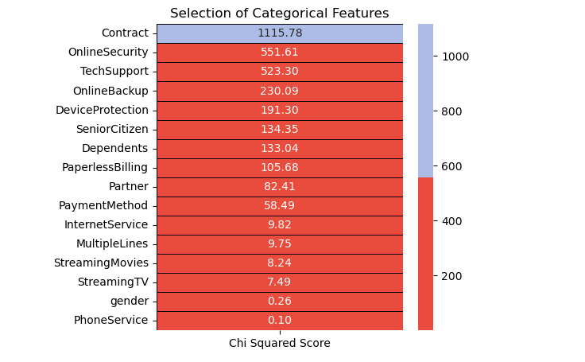
Phone Service, gender, Streaming TV, Streaming Movies, Multiple Lines and Internet Service display a very low relation with Churn.

Slide 13
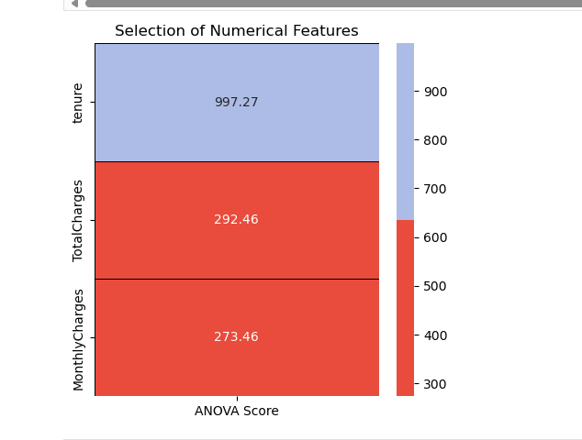
According to the ANOVA test, higher the value of the ANOVA score, higher the importance of the feature. From the above results, we need to include all the numerical features for modeling.

Slide 14
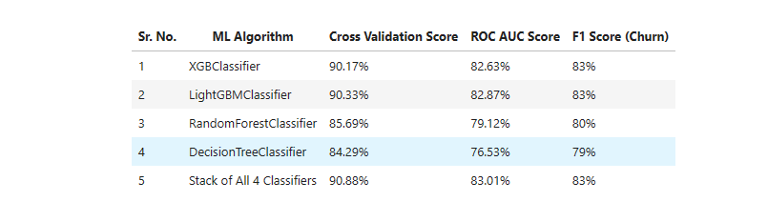
DIFFERENT TYPE OF MODEL USED AND THE ML ALGORITHMRESULTS OBTAINED

Slide 15
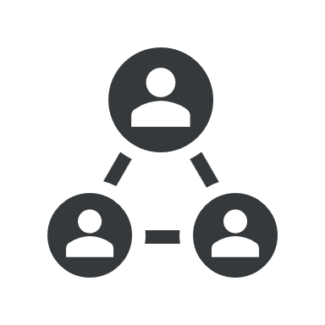


HOW WE GET THERE
ROI
SUPPLY CHAINS
NICHE MARKETS
3 types of customers should be targeted: Senior Citizen, Living with a Partner, living all alone!
The number of Senior Citizen customers are low but their lower limit of Monthly Charges is higher than the other customers. Thus, Senior Citizen customers are ready to pay top dollar but they need to catered with that level of service. For customers with a Partner as well as customers living alone, they prefer services with Monthly Charges below 65.
Once they build a solid pipeline of support services for customers, they need to push the usage of Multiple Lines & Fiber Optic cables for the Phone Service & Internet Service respectively. But the major hurdle for these 2 services is the starting point of 75+ in Monthly Charges.
Thus, they need to create combinations of options provided for Phone Service & Internet Service where average of these Monthly Charges will be in the range of 100 - 120
In order to create a strong foundation of customers, Telco Company needs to create an easy and affordable entry point for their services. For the tenure of 1st 6 months, it needs to focus extensively on Online Security, Online Backup, Device Protection & Tech Support as this period is the most critical and uncertain for the customers. They must lower the churn tenure of 40 - 50 months for these services!.

Slide 16

SUMMARY
Insights gained from the EDA are very valuable for understanding the effectiveness of the existing systems that are in place. They also assist in drawing up plans & measures to counter the problems or be in an infinite loop for improvement.
When it comes to model performance, feature creation by combining features was carried out however, they did not outperform the current models. Hyperparamter tuning & outlier detection could also bump up the F1 Score (Churn) & Cross Validation Score. Stack of models pipped the XGBClassifier & LGBMClassifier by a margin of 0.01 for F1 Score (Churn)

Slide 17
THANK YOU
DAVID JACOB IKECHUKWU
worldawaited2020@gmail.com
djmatrix4life@gmail.com

